Slide 1

Classifying Severity of Colorectal Cancer
MIS 536 - Business Analytics
Professor : Dr. Moqri
Presented by:
Team 1 - Ajinkya Koshti, Kavita Jain, Ludmila Scott, Pallabi Chatterjee, Tyler Kutz

Slide 2
Agenda
Introduction/Importance
Source/Data Content
Exploratory Analytics
Predictive Analytics
Interesting Insights

Slide 3

Where is colon in our body?
Notes:
https://www.cancer.net/navigating-cancer-care/diagnosing-cancer/stages-cancer

Slide 4
Facts & Statistics
Colorectal cancer is the second leading cause of cancer death in USA
There will be an estimated 140,250 new cases of colorectal cancer in 2019.
One in 20 people will be diagnosed with colorectal cancer.
One in three people are not up-to-date with colorectal cancer screening.
60% of colorectal cancer deaths could be prevented with screening
25% of people diagnosed with colorectal cancer have a family history.

Slide 5
Importance
Colorectal cancer is a public health issue
Correctly classifying how severe someone’s cancer is important because:
Determines treatment plan
Predicts chance of recovery
Help identify clinical trials
Sets expectations
Notes:
Since there is no definitive cure for cancer, it becomes crucial to work towards early detection measures, treatments, and follow-up methods that are proven to save lives
Plan treatment, including the type of surgery and/or whether chemotherapy or radiation therapy are needed
Predict the chance that the cancer will come back after the original treatment
Predict the chance of recovery
Talk about the diagnosis in a clear, common language with the entire health care team
Determine how well the treatment worked
Compare how well new treatments work among large groups of people with the same diagnosis

Slide 6
Data Overview
Source
Detailed documentation and glossary of statistical terms in the website SEER
Content
Research data includes SEER incidence and population data associated by age, sex, race, year of diagnosis, and geographic areas (including SEER registry and county).
Link: https://seer.cancer.gov/

Slide 7
Data Overview Cont’d
Scale of measurement of our target variable is ordinal in nature
The 2000-2016 colon/rectal cancer dataset has 939,119 records, 35 columns and has a file size of 200 MB.

Slide 8
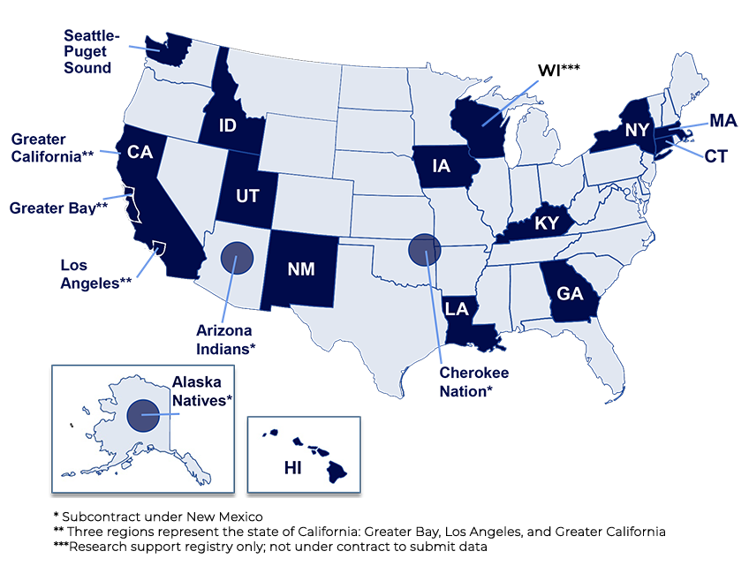
SEER Registries

Slide 9
Exploratory Analytics

Slide 10
Dataset - Statistics
939119 observations
35 variables in total
Data format (tabular, database or file format, etc.)
Data tables (how many, their content/organization, etc.)
Data columns (most important ones, etc.)
Data rows (unit of observation, count, etc.)

Slide 11
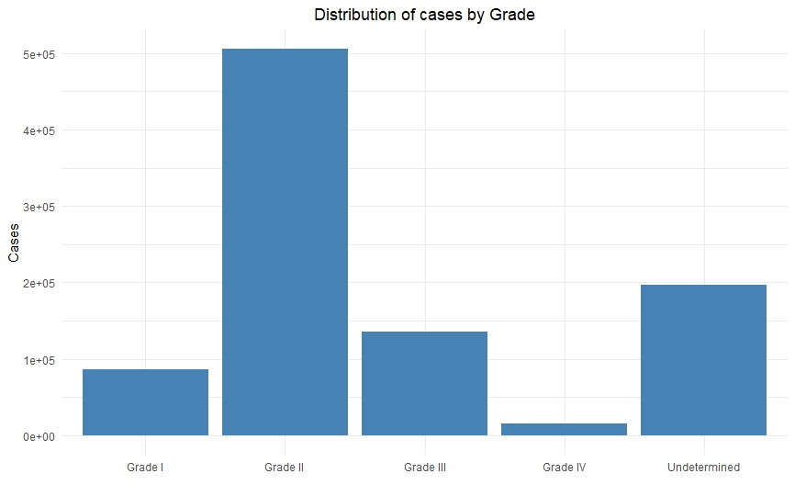
Charts/Visualization

Slide 12
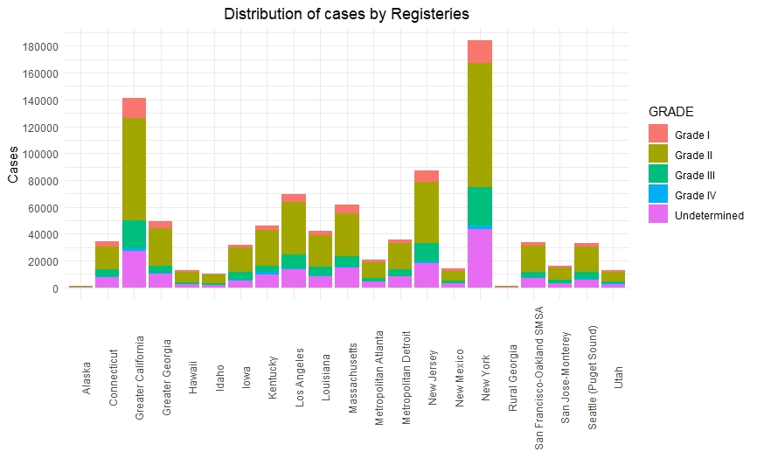
Charts/Visualization

Slide 13
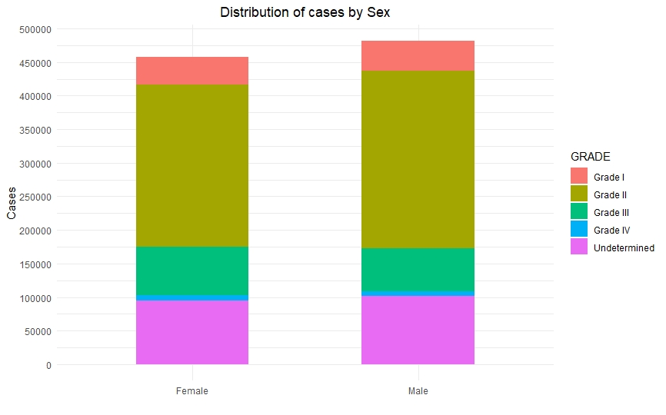
Charts/Visualization

Slide 14
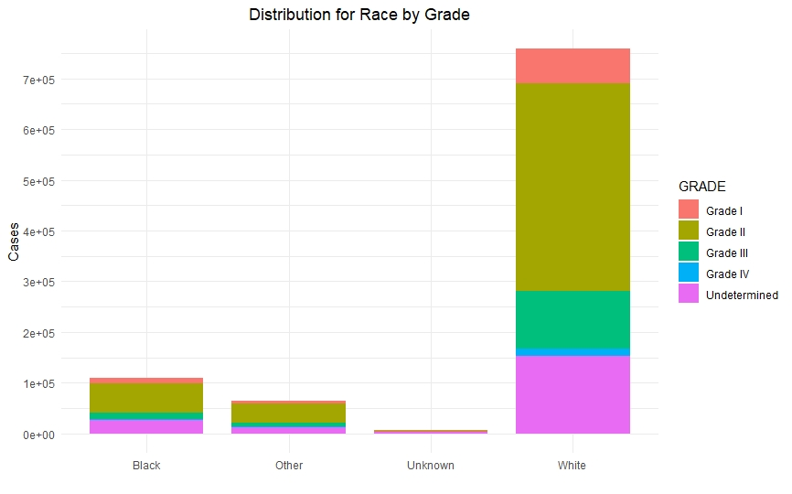
Charts/Visualization

Slide 15
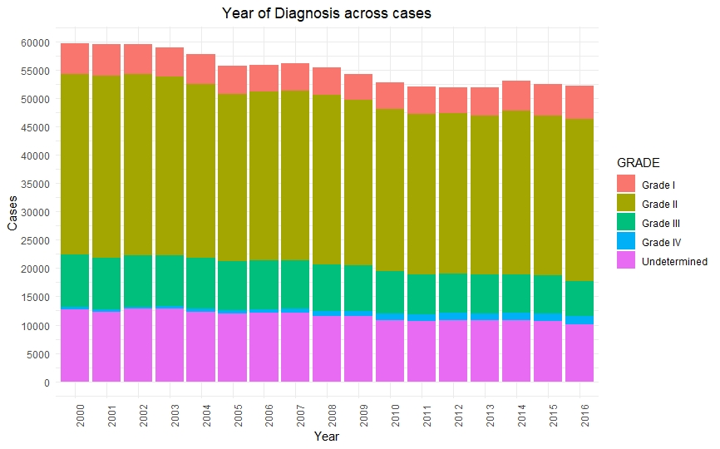
Charts/Visualization

Slide 16
Predictive Analytics

Slide 17
Predictive Analysis Steps
Data Preprocessing
Feature Engineering/Dimension Reduction
Predictive Modeling
Tuning the models

Slide 18
Data Preprocessing
Raw data: ASCII file with encoded features
Converting ASCII to CSV
Decoding the encoded features
Dealing with high cardinality
Label encoding/ one hot encoding based on features
E.g Sequence number: Label Encoding
Reporting source: OHE
Normalization
Standardization
Scaling

Slide 19
Feature Engineering/Dimension Reduction
Raw data: 34 features
Cleaned data: 98 features
Eliminating multicollinearity
PCA
After feature reduction: 87 features

Slide 20
Predictive Modeling
Baseline classification models:
Logistic Regression
Decision Trees
Random Forests, Bagging, Boosting
Nearest Neighbors
Parameter Tuning

Slide 21
Interesting Insights

Slide 22
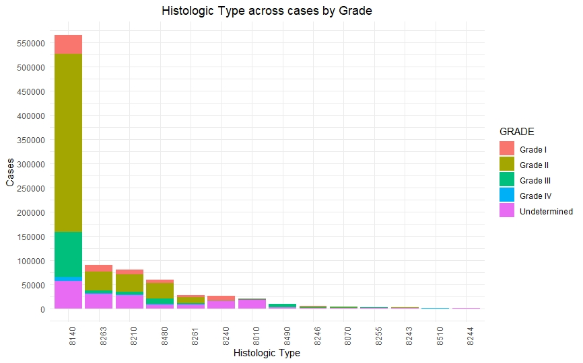
Histological Type Risk
Most are adenomas and adenocarcinomas
8480 indicates mucoepidermoid and neoplasms
May have a higher risk of grade 3 or 4

Slide 23
Conclusion
Colorectal cancer 2nd most fatal cancer
Attempting to classify patients by grade
Potential case for oversampling techniques
Will predict who is at risk for highly aggressive cancer

Slide 24
Thanks!
Any questions?

